Slide 1
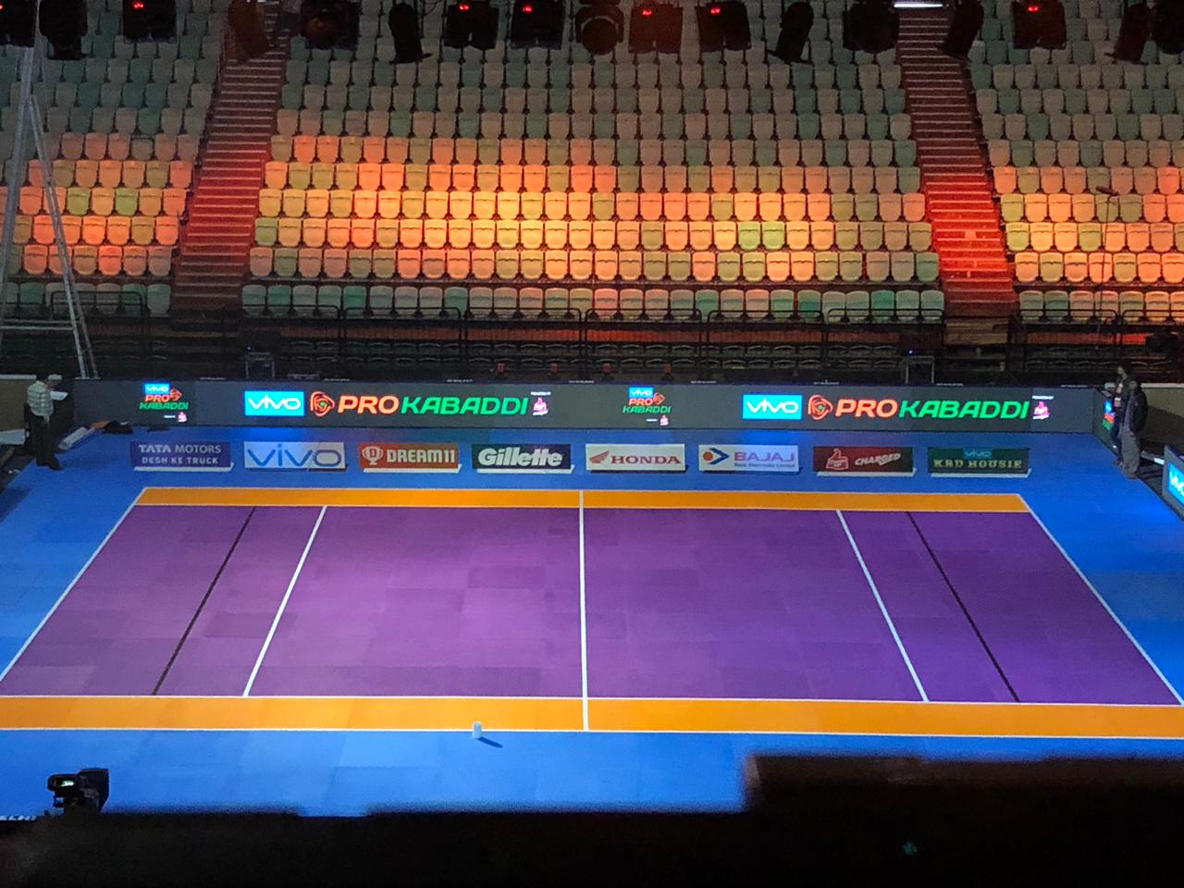
SPORT(kabaddi)
Vishal magar
Deepak pitale

Slide 2

Kabaddi connect: Displaying Event Registrations and info online
Using Google Forms and a Responsive Website
Your Name / Team Name / College Name
[Add Kabaddi-related image or logo]

Slide 3
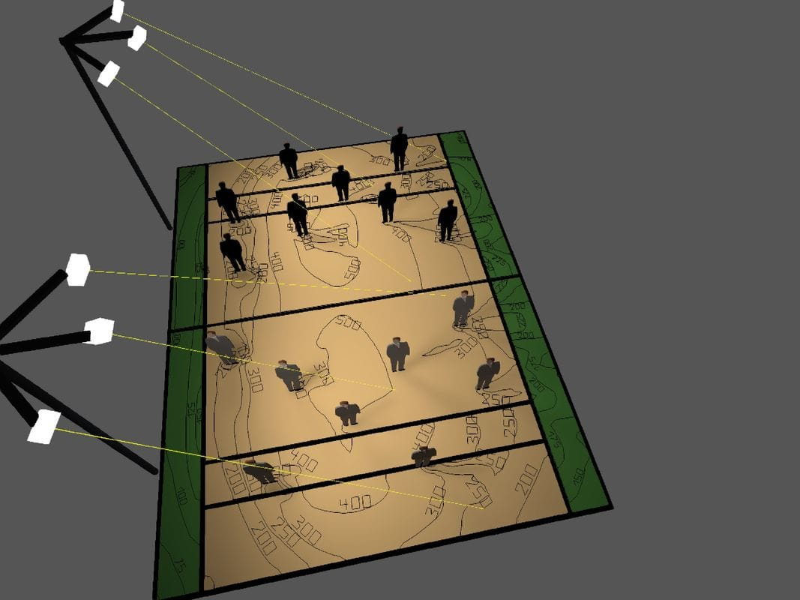
Introduction
College Kabaddi players need easy access to event info and registration updates .
Manual updates are time-consuming and prone to errors .
Solution: Collect data via Google Forms and display it dynamically on the website .

Slide 4
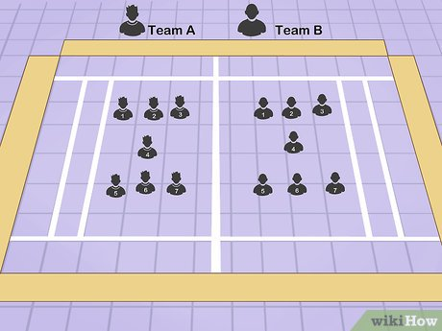
Objective
- Collect player and event info through Google Forms .
- Display registration data on the website in a clear and accessible way .
- Ensure real-time updates for organizers and participants.

Slide 5

Problem Statement
Students miss important info about Kabaddi events .
Manual tracking of registrations is inefficient.
No centralized platform for viewing participant details.

Slide 6
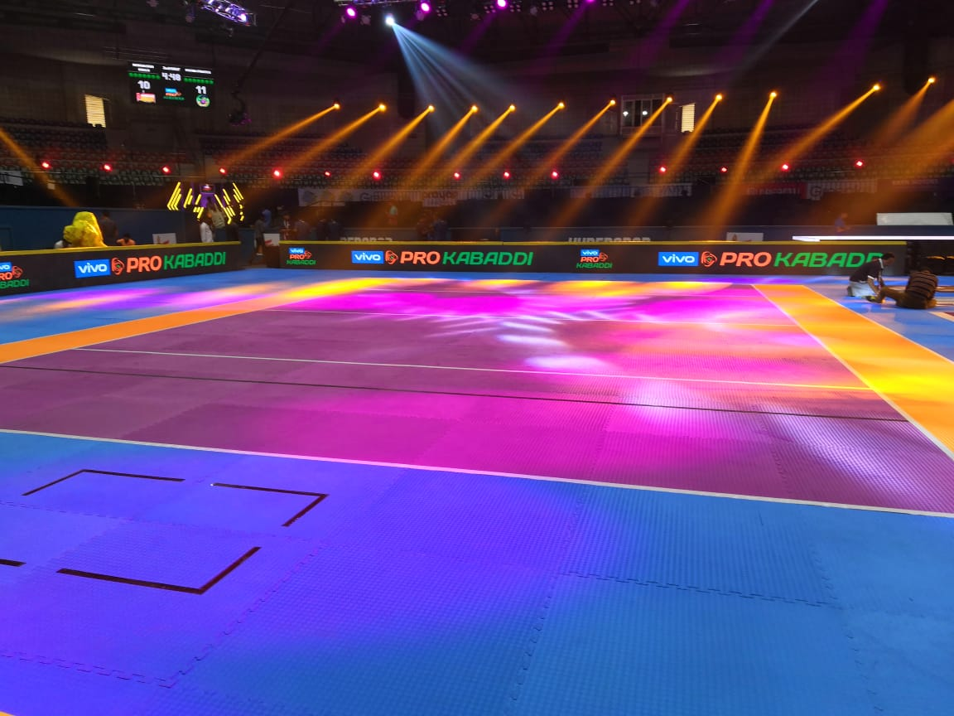
Proposed Solution
Create a Google Form for registration and info submission .
Link it to a Google Sheet .
Use website integration to display data dynamically.

Slide 7
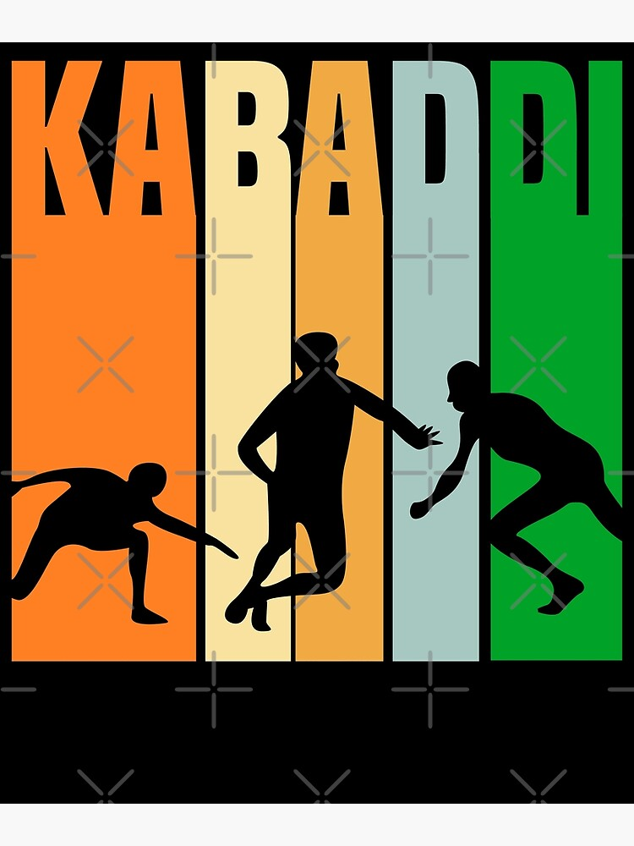
How It Work
1. Students fill out the Google Form.
2. Responses are saved in Google Sheets automatically.
3. Website fetches the data from Google Sheets.
4. Data displayed in a table or list on the site.

Slide 8

Technology Used
Google Forms & Google Sheets - Data collection and storage
HTML, CSS, JavaScript - Frontend development
Google Visualization API / Embedded SheetsDisplay data on website
Responsive Design - Mobile & desktop friendly

Slide 9

Features of the Website
Home page with event highlights
Registration info displayed dynamically
Player and team info table
Easy navigation and responsive layout

Slide 10

Webdite Screenshots/ Mockup
[Add screenshots of your HTML pages or mockup designs]
Event Info Table
Registration Page
Home Page

Slide 11
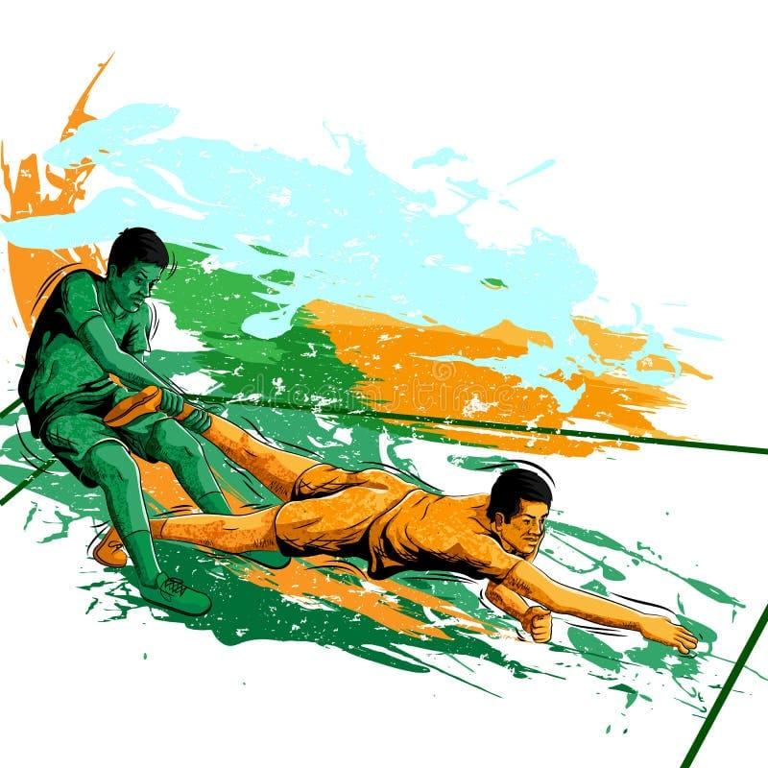
Benefits
Easy access to registration and event info .
Real-time updates for organizers and players .
Reduces manual work and errors .
Encourages more participation in college Kabaddi.

Slide 12

Conclusion
Kabaddi Connect simplifies registration tracking and info sharing.
Helps promote sports culture in colleges .
Provides a centralized digital platform for all Kabaddi-related info.

Slide 13
Thank You!

